Slide 2
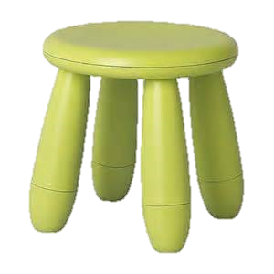
COW

Slide 3
DOG

Slide 4
CAT

Slide 5
PIG

Slide 6
DUCK

Slide 7
HORSE

Slide 8
FISH

Slide 9
SNAKE

Slide 10
LION

Slide 11
BEAR

Slide 12
MONKEY

Slide 13
ELEPHANT

