Slide 1
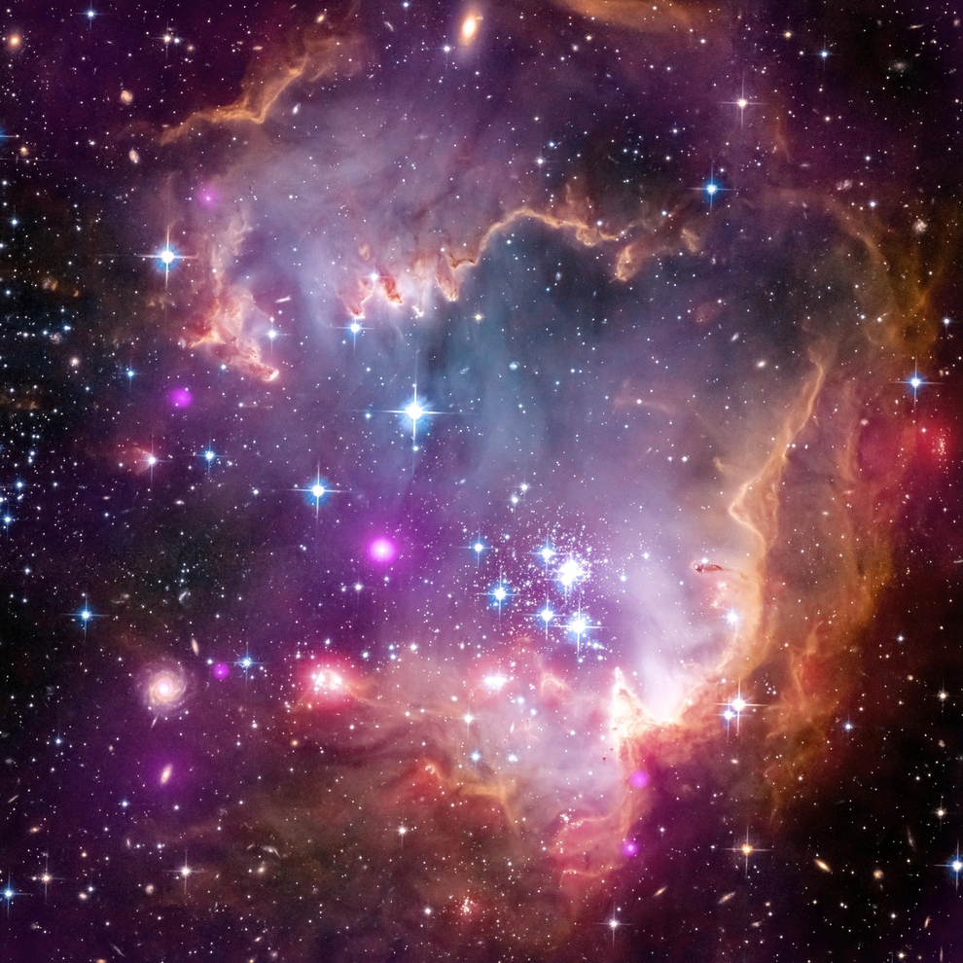
2
4
6
8
10
3
5
7
9
11

Slide 2
There are ____ ____________.
B

