Slide 1
NUMBERS

Slide 2
1 2 3 4 5 6 7 8 9 10 11 12 13 14 15 16 17 18 19 20

Slide 3
1
1 One

Slide 4
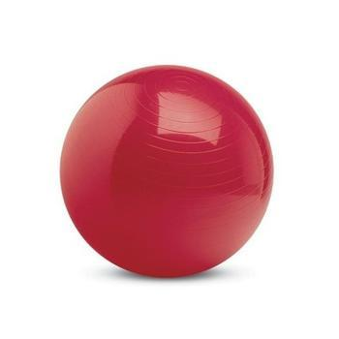
2
2 Two

Slide 5
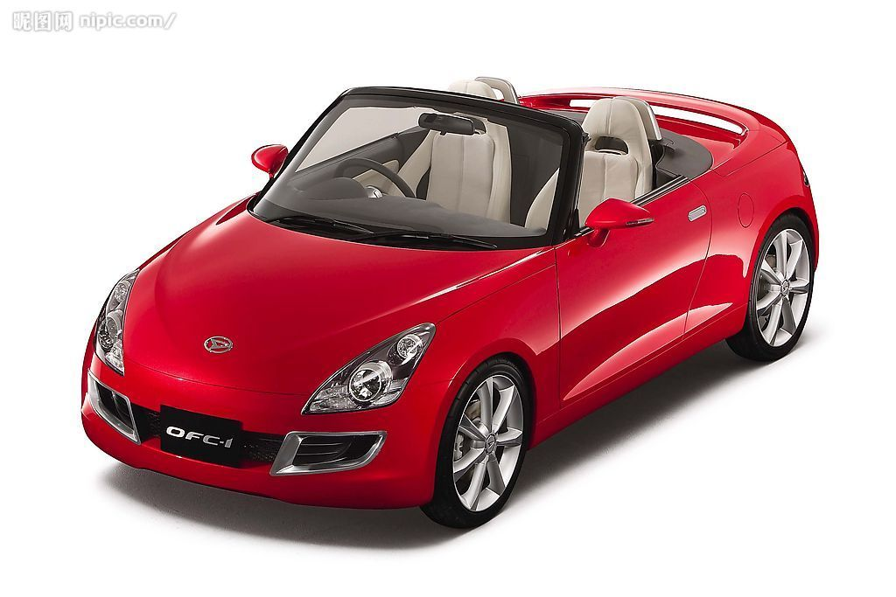
3
3 Three

Slide 6
4
4 Four

Slide 7
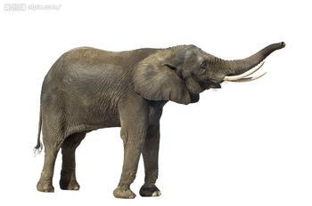
5
5 Five

Slide 8
6
6 Six

Slide 9
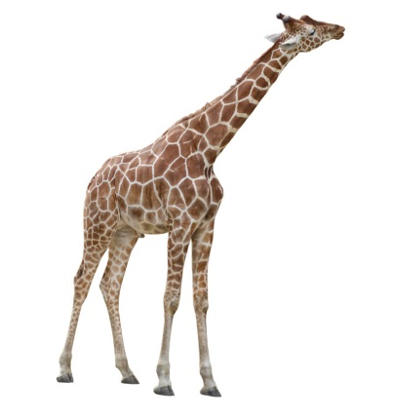
7
7 Seven

Slide 10
8
8 Eight

Slide 11
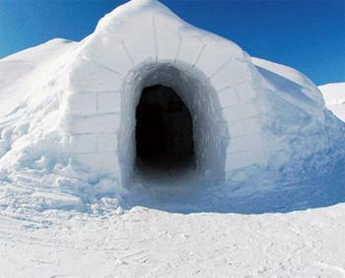
9
9 Nine

Slide 12
10
10 Ten

Slide 13
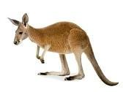
11
11

Slide 14
12
12

Slide 15
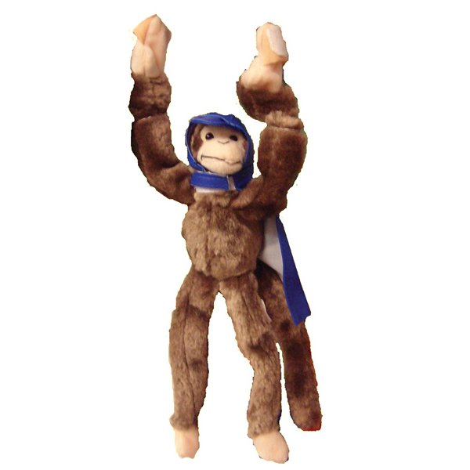
13
13

Slide 16
14
9
14

Slide 17
15
15

Slide 18
16
16

Slide 19
17
17

Slide 20
18
18

Slide 21
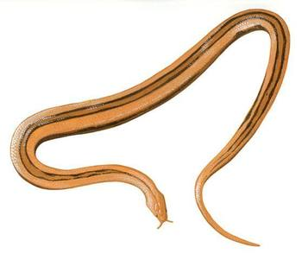
19
19

Slide 22
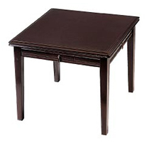
20
20

