Slide 2
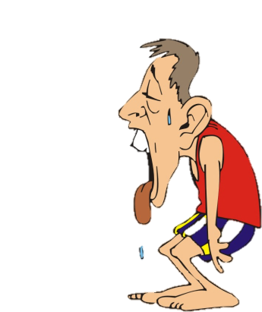
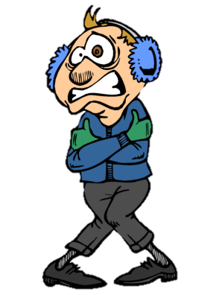
Hot
Cold

Slide 3
Hot
Cold

Slide 4
Hot
Cold

Slide 5
Hot
Cold

Slide 6
Hot
Cold

